Slide 1



Lecture 3: Working with multiple clients
COMP260: Distributed Systems
BSc (Hons) Computing for Games

Slide 2
Today’s session:
Exception-based programming
Threading
PyQt programming

Slide 3
Exception-based programming

Slide 4
Exception-based programming
Last week we looked at client and server as state machines
Server
accept
receive
send
Wait for a client
Receive
message
Send
message
catch exception
Client
connect
send
receive
Connect to server
send
message
Receive
message
catch exception

Slide 5
Exception-based programming
Last week we looked at client and server as state machines
Use exceptions to determine when state transitions occur (or don’t occur)

Slide 6
Exception-based programming
Last week we looked at client and server as state machines
Client
Failure to connect to server (server not running)
Failure to send message (loss of server)
Failure to receive message (loss of server)
Server
Failure to send message (loss of client)
Failure to receive message (loss of client)

Slide 7
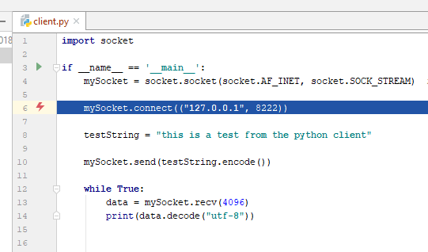
Exception-based programming
Use exceptions as a robustness device
This is not robust ;)

Slide 8
Exception-based programming
Client-side exceptions as a robustness device
From the client state diagram, we have two states
Client
connect
send
receive
Connect to server
send
message
Receive
message
catch exception
Not connected to the server
Connected to the server

Slide 9
Exception-based programming
Client-side exceptions as a robustness device
From the client state diagram, we have two states
Not connected to the server
Transition to connected to server when connect succeeds
If socket.connect fails, it will throw an exception
We must catch this and stay in current state
Connected to the server
Transition to not connected to the server when send() or recv()
If socket.send() or socket.recv() fail, they will throw an exception
We must catch this and go into the not connected state
And release the current socket (as it’s done)

Slide 10
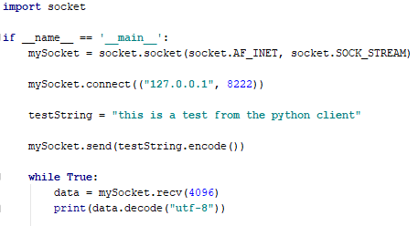
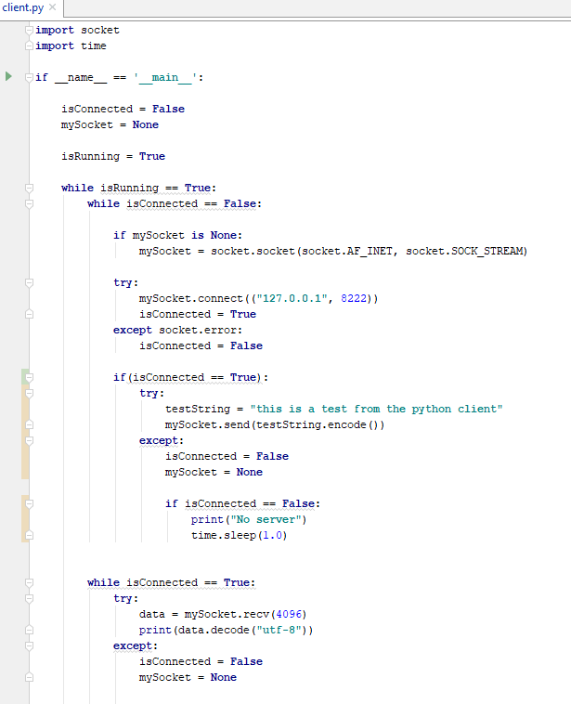
Exception-based programming
Client-side exceptions as a robustness device
Robustness is slightly more complex than non-robust code

Slide 11
Exception-based programming
Client-side exceptions as a robustness device
The application will sit running in a while loop for isRunning.
With the two state realised as isConnected
The socket needs to be recycled, it can be set to None to trigger a new socket to the server
The client will try and connect to the sever, if it fails it will wait for 1sec and try again

Slide 12
Exception-based programming
Client-side exceptions as a robustness device
If it connects, it will try and send a message to the server. If send fails, it no longer has a connection and will:
Bin the socket
Go to the non-connected state
If the client is connected, it will sit in the while loop until the socket.recv throws and exceptionand will:
Bin the socket
Go to the non-connected state

Slide 13
Exception-based programming
Client-side exceptions as a robustness device
This will run and re-connect to the server as it becomes available
Set isRunning to false to quit the application

Slide 14
Exception-based programming
Server-side exceptions as a robustness device
From the server state diagram, we have two states
Server
accept
receive
send
Wait for a client
Receive
message
Send
message
catch exception
Doesn’t have a client
Does have a client

Slide 15
Exception-based programming
Server-side exceptions as a robustness device
From the server state diagram, we have two states
Doesn’t have a client
Transition to does have a client when a client connection is accepted
Socket.accept can’t fail
Does have a client
Transition to doesn’t have a client when send() or recv() fail
If socket.send() or socket.recv() fail, they will throw an exception
We must catch this and go into the doesn’t have a client
By definition we release the current socket as it’s no longer a connection

Slide 16
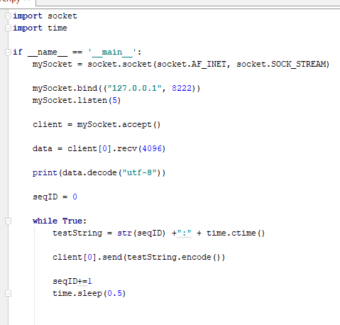
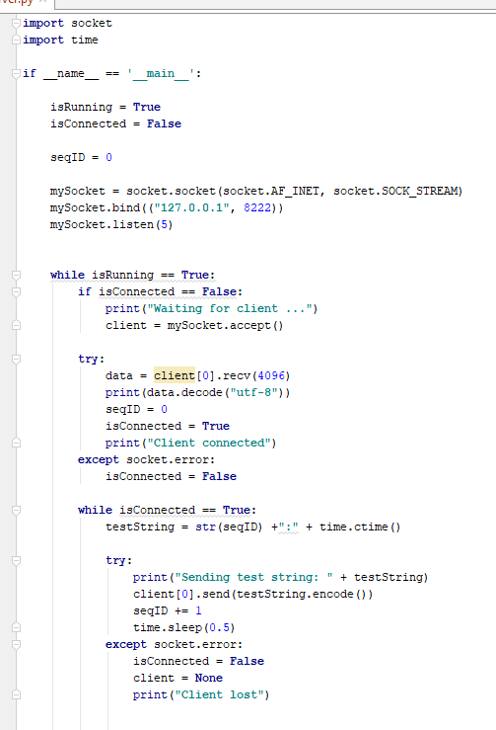
Exception-based programming
Server-side exceptions as a robustness device
Again, robustness is slightly more complex than non-robust code

Slide 17
Exception-based programming
Server-side exceptions as a robustness device
Unlike the client, the server has 2 sockets; its socket and whatever client connects, so client = None on failure, not the server socket
Again, the server is a 2 state machine using isConnected and except socket.error to detect network failure conditions
I added some debug print() to get a clear idea of what was going on with the server states

Slide 18
Threading

Slide 19
Threading
Now we have a robust architecture, it would be nice to work with lots of clients
However, there are two problems:
1. socket.accept () needs to be called for all clients
Need an architecture that supports this
& accept is blocking, so you can’t put it in a main loop
2. socket.receive() is a blocking function
Not much of an issue at client and server don’t do much
by blocking, you can’t put it in a main loop
By blocking, execution will wait at that function until it returns

Slide 20
Threading
Basic concepts of threads
Threads run a function alongside the main (thread) program execution
Threads can share classes, functions & data with the main program, but care needs to be taken so that data isn’t being read and written at the same time.
Write your programs to be aware of this condition
Use thread-safe datatypes
Use data locks to prevent access

Slide 21
Threading
Now we have a robust architecture, it would be nice to work with lots of clients
Server
Accept behaviour
Normal behaviour
Receive behaviour
Wait for any clients
send
Receive
message
Send message
Client
Client
Client
Normal behaviour
Receive behaviour
Normal behaviour
Receive behaviour
send
Receive
message
Normal behaviour
Receive behaviour
send
Receive
message
Send message
Receive
message
send
Send message
Send message

Slide 22
Threading
1. socket.accept () is a blocking function but also needs to be called for all clients
This is a server issue
We need to have a thread that will handle socket.accept()
All the sockets accepted will need to be stored
And then processed with socket.send() on the main thread
This means we need to think about data protection
Sockets will be discovered in a thread and added to a list
That is used (accessed) on the main thread
Scope for bad things to occur
Inconsistent failures on the list (key footprint of thread issues)

Slide 23
Threading
1. socket.accept () is a blocking function but also needs to be called for all clients
Put accept() into a thread
In the accept thread, add the newly connected socket into a global container
The global container will be used in the main function to send messages to all client
Therefore, the contain will need to be locked so that the accept thread and main thread don’t access it at the same time
If socket.send() fails, the client is lost
Remove it from the global container of clients
Typically, the global container will be a list<socket> or dictionary<socket, data>
Socket is the most useful key to use for this

Slide 24
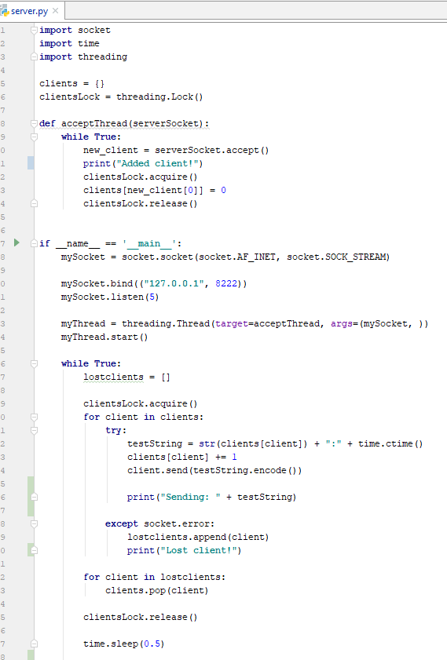
Threading
1. socket.accept () is a blocking function but also needs to be called for all clients
This is my accept thread.
It runs in the background and puts new clients into a list of clients
To stop the main thread causing problems with the list I lock it before I use it

Slide 25
Threading
1. socket.accept () is a blocking function but also needs to be called for all clients
This is my main thread.
It is based on a simple (non-robust) server
It launches the accept thread and runs in a while loop sending messages to whatever clients are connected
In the update, it acquires the client lock to stop the accept thread from adding clients to the clients list while it is processing them
If a client.send() fails, the client is put into a list of lost clients and deleted after the update

Slide 26
Threading
2. socket.recv () is a blocking function
This is a server and client issue
We’ll look it from the client side
Clients do ‘some work’ while waiting to receive a message form the server
We need to have a thread that will handle socket.recv()
And process the data

Slide 27
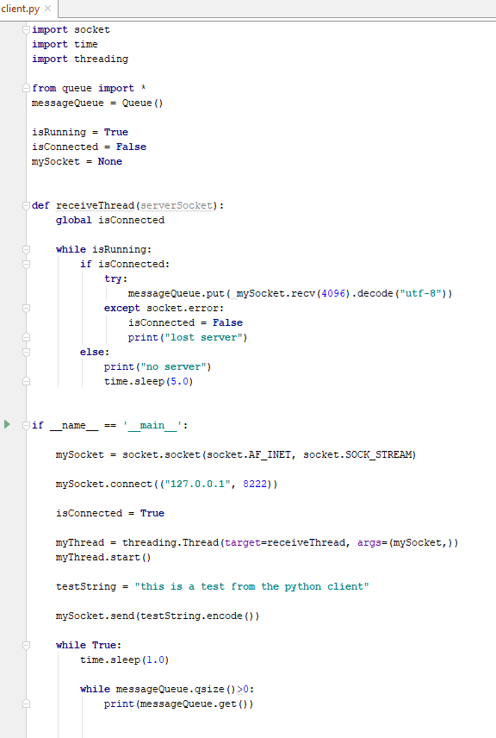
Threading
2. socket.recv () is a blocking function
The receive thread picks up server messages and puts them into a lock-free queue (so no locks)

Slide 28
Threading
2. socket.recv () is a blocking function
The main thread will iterate through the message queue (again with no locks)
Python is good for lock-free data structures, but their support isn’t universal

Slide 29
Threading
We can extend the threading approach so that both client and server applications can run their socket.receive() as threads.
However, command line applications are limited
User input blocks screen updates
So, to do more interactive applications, we need to move to a better environment

Slide 30
PyQt programming

Slide 31
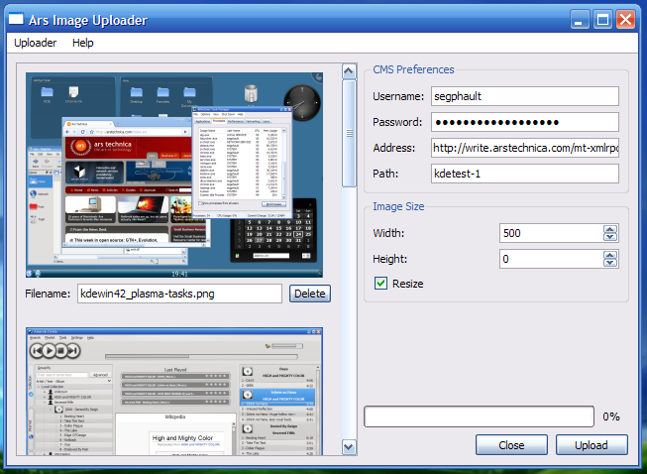
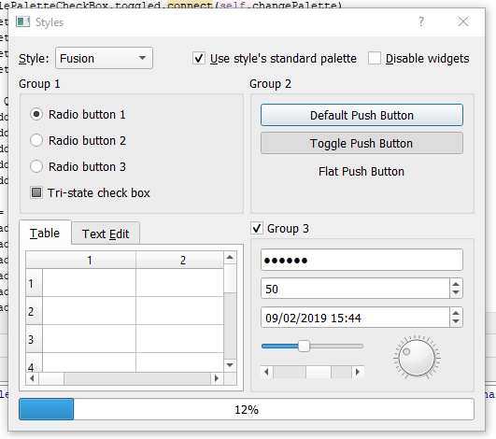
PyQt programming
Conceptually
PyQt provides an application framework for doing event-driven programming
Very useful for UI rich applications
Application runs of user evens (mouse clicks on widgets, menus etc)
just like winforms or windows presentation foundation (wpf)
Rather than logic-draw loop of game engines / pyGame
(Hopefully) far better input control than pyGame

Slide 32
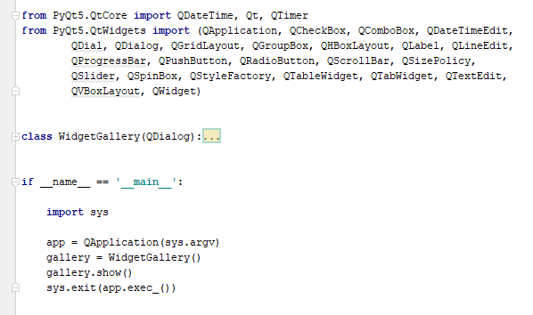
PyQt programming
Conceptually
PyQt-based applications run from main as a QApplication
Application components / widgets are derived from Qclasses (QDialog, Qwidget etc)

Slide 33
PyQt programming
Conceptually
Much of Qt is event-based
Create a widget and add an functions to callbacks
However,
For threaded updates, you need to preserve Qt’s thread model
You can’t write directly to Qt containers / variables -> thread violations will occur sooner or later
Qt timerevent is a good starting point
Periodic update of components in the correct thread context

Slide 34
PyQt programming
Conceptually
Server
Client
Main Thread
Receive Thread
Main Thread
Active client container
Do main processing
Send messages
Get incoming messages
Do event-driven processing
Receive Thread
Queue of work
Update
Qt view
Queue of work
Get incoming messages
App Thread
Accept Thread
Do application processing
Wait for clients

Slide 35
Questions

